Slide 1

Machine Learning Foundations:
A Case Study Approach
Par Kai HUANG

Slide 2
CONTENTS
Introduction
Project
1
2
3
4
Development
Conclusion

Slide 3
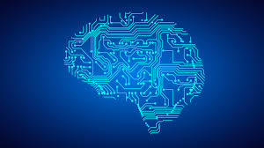
Introduction
A course in University of Washington
Machine Learning is a subject which is combined by statistic and computer science
PAGE: 01

Slide 4
Introduction
Objective
Identify potential applications of machine learning in practice.
Describe the core differences in analyses enabled by regression, classification, and clustering.
Select the appropriate machine learning task for a potential application.
Apply regression, classification, clustering, retrieval, recommender systems, and deep learning.
Represent data as features to serve as input to machine learning models.
Assess the model quality in terms of relevant error metrics for each task.
Utilize a dataset to fit a model to analyse new data.
Implement these techniques in Python.
PAGE: 02

Slide 5
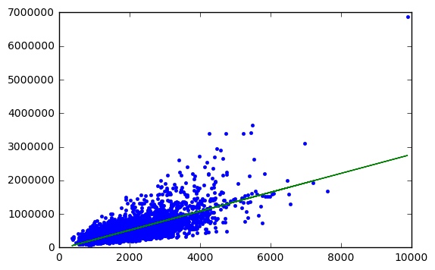
Development
Regression: Predicting house prices.
Regression is a statistical process for estimating the relationships among variables.
How to predict house prices ?
Linear regression ? Quadratic function ? Polynomial regression?
Multiple linear regression ?
PAGE: 03

Slide 6
Development
Regression: Predicting house prices.
How to evaluate our model ?
Residual Squared Error
Root Mean Squared Error
Overfitting
RMSE
With 1 feature: 255191
With 6 features: 179542
PAGE: 04

Slide 7
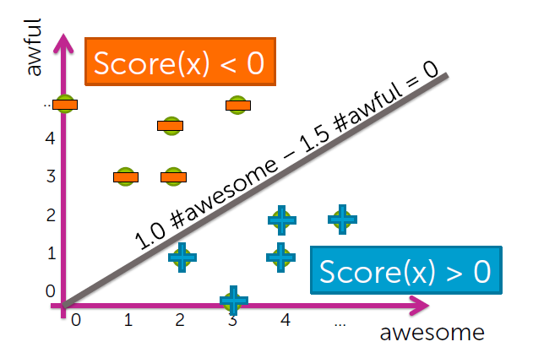
Development
Classification: Analysing sentiment
In machine learning, classification is the problem of identifying to which of a set of categories (sub-populations) a new observation belongs, on the basis of a training set of data containing observations (or instances) whose category membership is known.
PAGE: 05

Slide 8
Development
Classification: Analysing sentiment
Binary classification
Count words
Give every word a weight
Calculate the score
Evaluate the classification model with error and accuracy
Final results
Accuracy: 0.92
Error: 0.08
PAGE: 06

Slide 9
Development
Clustering and similarity: Retrieving documents
Term frequency – inverse document frequency(TF-IDF)
Term frequency (count of the word in the current article)
Inverse document frequency
= log ((#docs) / (1 + #docs using word))
Similarity(doc1, doc2) =
TF-IDF1 .* TF-IDF2
Apply 1-nearest neighbour algorithm:
Search over each article in corpus
Compute s = similarity (doc1, Query_article)
If s > Best_s, record Most_similar_article = doc1 and set Best_s = s
Return Most_similar_article
PAGE: 08

Slide 10
Development
Clustering and similarity: Retrieving documents
Clustering is the task of grouping a set of objects in such a way that objects in the same group (called a cluster) are more similar (in some sense or another) to each other than to those in other groups (clusters).
PAGE: 07

Slide 11
Development
Clustering and similarity: Retrieving documents
K-means algorithm
1.Initialize cluster centers.
2. Assign observations to closest cluster center.
3. Revise cluster centers as mean of assigned observations.
4. Repeat 2 + 3 until convergence
PAGE: 09

Slide 12
Development
Recommending products
Collaborative filtering is a method of making automatic predictions(filtering) about the interests of a user by collecting preferences or taste information from many users (collaborating).
Using collaborative filtering to recommend songs for users.
Evaluate the model with precision and recall.
Precision = # (liked and shown) / #shown
Recall = # (liked and shown) / #liked
AUC (area under the curve).
PAGE: 10

Slide 13
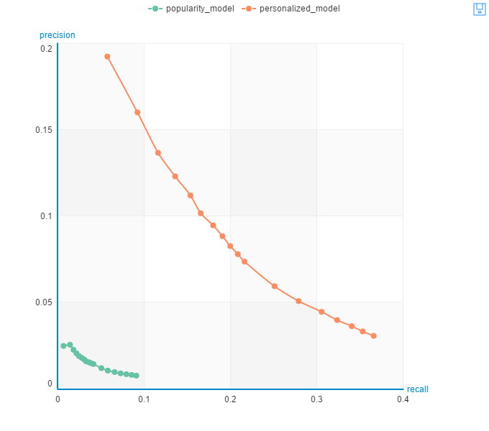
Development
Recommending products
PAGE: 11

Slide 14
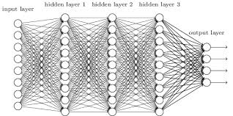
Development
Deep learning: Searching for images
Deep learning is a branch of machine learning, and it attempts to use high-level abstraction algorithms that involve complex structures or multiple processing layers made up of multiple nonlinear transformations.
PAGE: 12

Slide 15
Development
Deep learning: Searching for images
Extract deep features from images
Apply the K nearest neighbours algorithm on building a KNN model
Search similar images with this KNN model
PAGE: 13

Slide 16
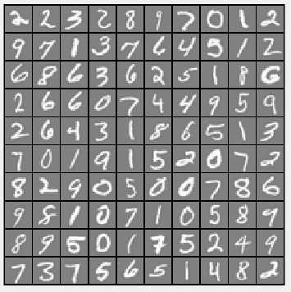
Project
Hand-written digit recognition
5000 training sample
Each : 20 pixel * 20 pixel
Neural network
PAGE: 14

Slide 17
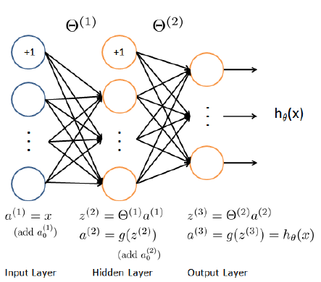
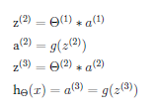
Project
Hand-written digit recognition: Forward propagation
PAGE: 15

Slide 18
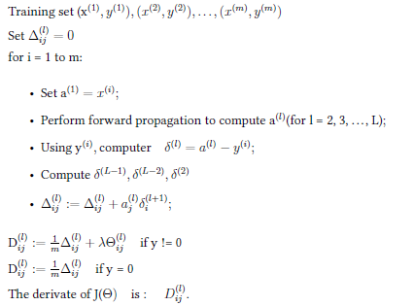
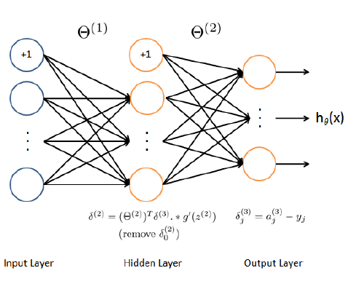
Project
Hand-written digit recognition: Backward propagation
PAGE: 16

Slide 19
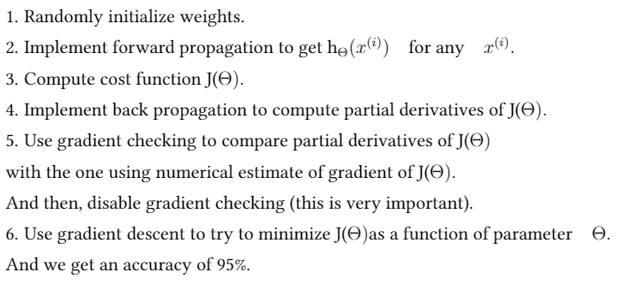
Project
Hand-written digit recognition: General
The accuracy is 95%.
PAGE: 17

Slide 20
Conclusion
Machine Learning is a power tool
Machine learning is widely used
This course give me a whole impression about machine learning
Lack of details
PAGE: 17

Slide 21
Thank you!

